Slide 1


CRYPTOGRAPHY
AND
TECHNIQUES

Slide 2
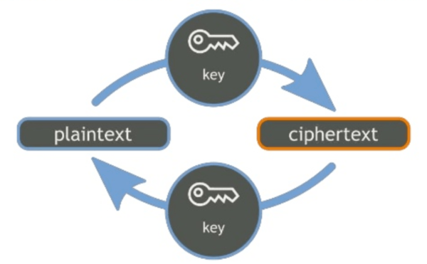
Cryptography:- This secret writing is
a strong tool for controlling against many
kind of security threat.

Slide 3
Encryption:- Encryption is the process of encoding a message so that the meaning is not obvious.
Decryption:- it is the reverse process, transforming an encrypted message back into its normal, original form.
Cryptosystem:- A system for encryption and decryption is called a cryptosystem.
Plaintext:- The original form of message is known as Plaintext. Represented by P
Ciphertext:- This is encrypted form of message. Represented by C
C = E(P) and P=D(C)

Slide 4
Encryption Algorithm
The set of rules which are defined under Cryptosystem for Encryption and Decryption of a message are known as Algorithms.
The algorithms used a device known as key denoted by k. The resulting Ciphertext depends upon the Plaintext message, the Algorithm and the Key value.
C = E(K,P)

Slide 5
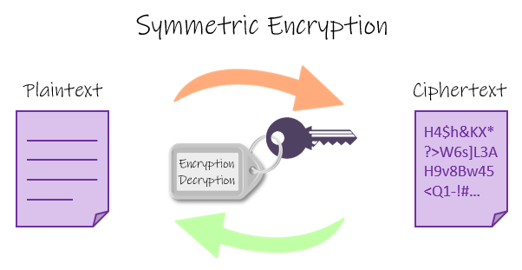
Cryptosystem is divided into two types as per distribution of the keys.
  Symmetric :- when both encryption and decryption key are same so
  P = D ( K, E ( K, P ) )

Slide 6
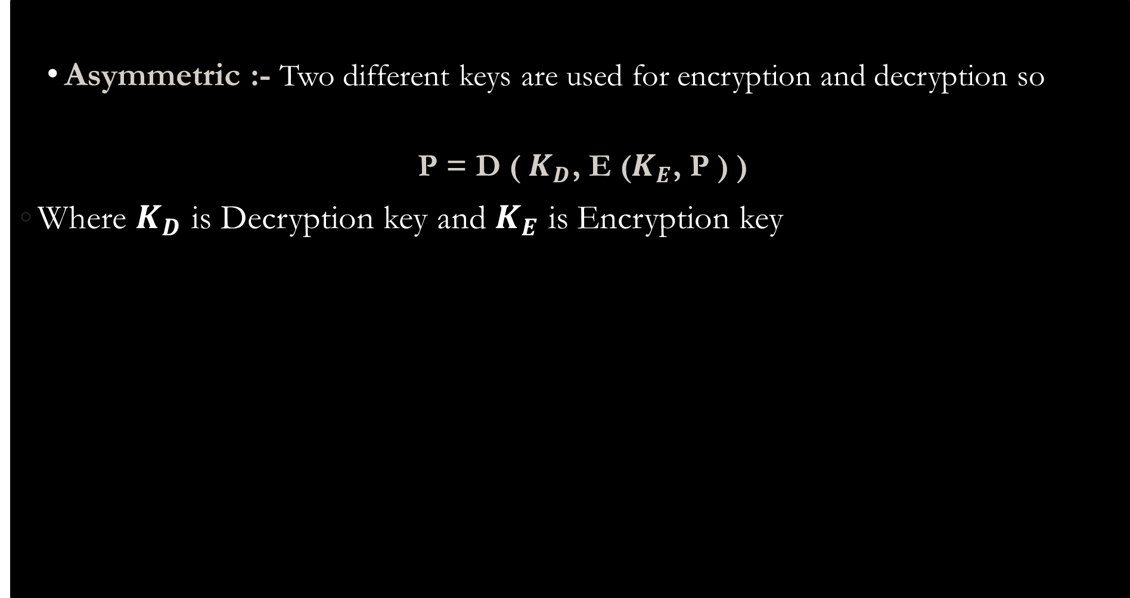
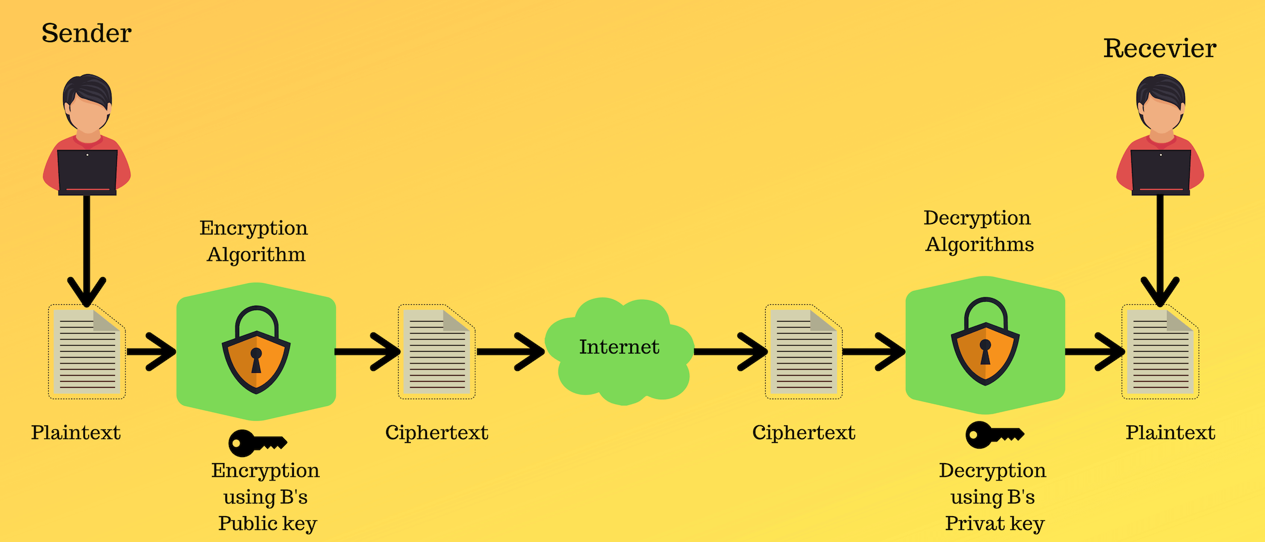

Slide 7
Cryptanalysis
The art and science of breaking ciphertext is known as cryptanalysis and a Cryptanalyst’s chore is to break an Encryption. eg. Brute Force search
Breakable Encryption
An encryption algorithm is called breakable when, in given enough time and data, an analyst can determine the algorithm.

Slide 8
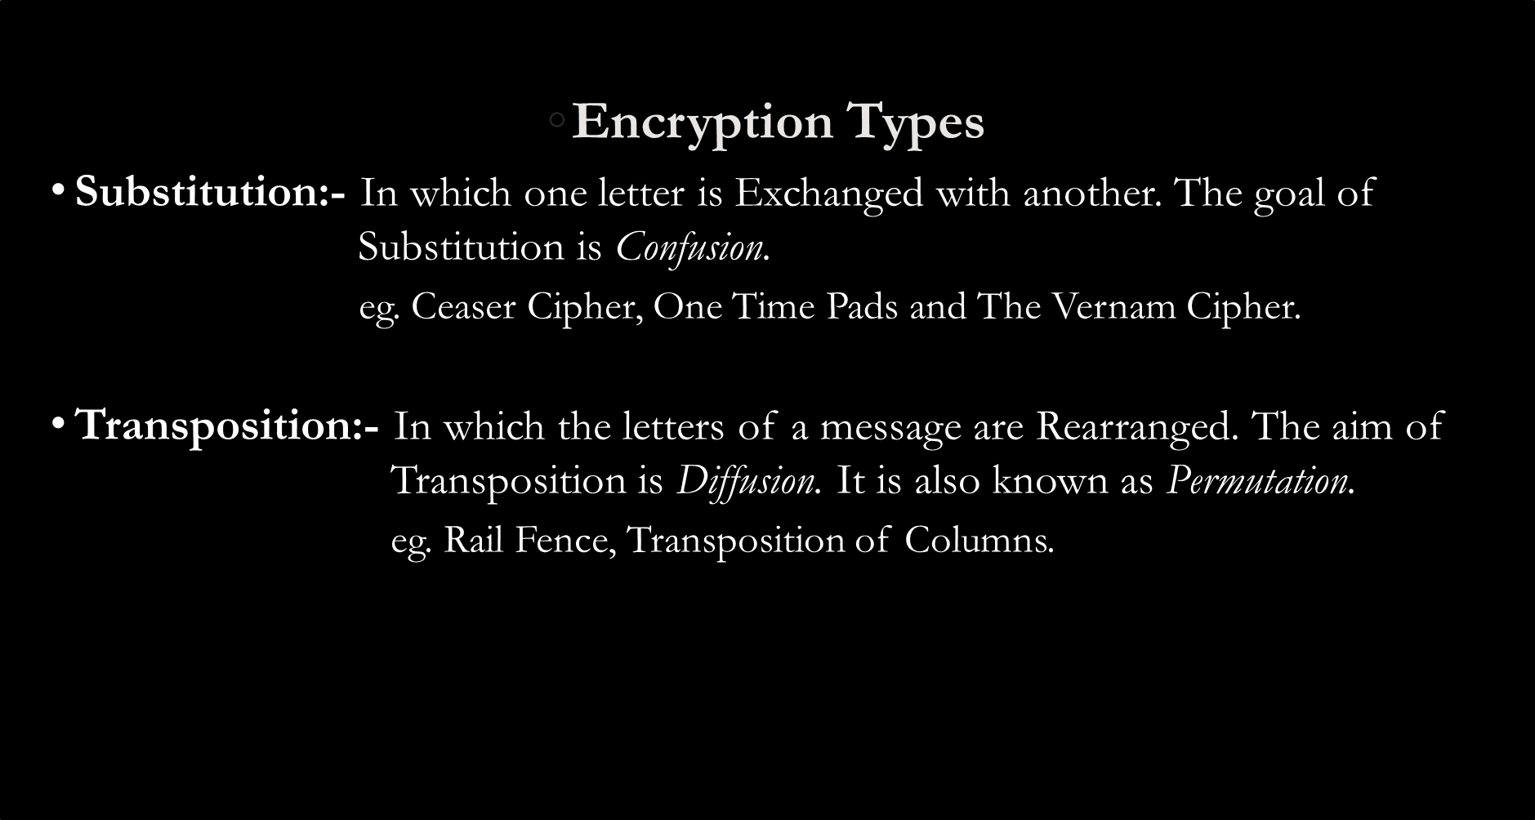

Slide 9
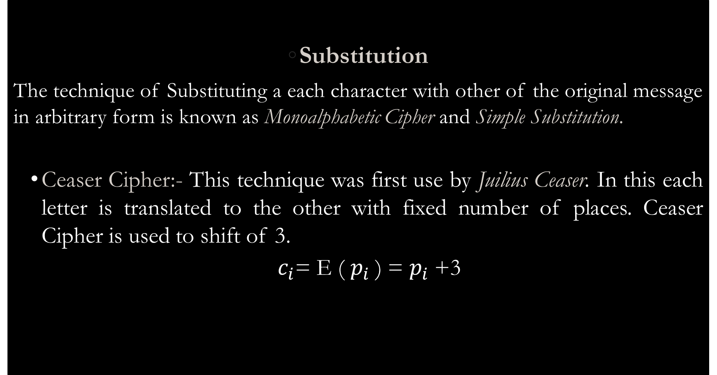

Slide 10
Plain Text A B C D E F G H I J K L M N O P Q R S T U V W X Y Z
Cipher Text D E F G H I J K L M N O P Q R S T U V W X Y Z A B C
  Eg. TREATY IMPOSSIBLE

Slide 11
Advantages and Disadvantages
  The Caesar cipher is quite simple
  The ability of predict the entire algorithm using small piece of ciphertext
Example of Ceaser Encryption
  Use the Ceaser Cipher to encrypt the meassage “LOVELY PROFESSIONAL UNIVERSITY” with key size 15.

Slide 12

Play fair Cipher
The scheme was invented in 1854 by Charles Wheatstone, but was named after Lord Playfair who promoted the use of the cipher. The technique encrypts pairs of letters (digraphs), instead of single letters as in the simple substitution cipher.
The Algorithm
The 'key' for a playfair cipher is generally a word, for the sake of example we will choose 'monarchy'. This is then used to generate a 'key square', e.g.
M O N A R
C H Y B D
E F G I/J K
L P Q S T
U V W X Z

Slide 13
Any sequence of 25 letters can be used as a key, so long as all letters are in it and there are no repeats. Note that there is no 'j', it is combined with 'i'. We now apply the encryption rules to encrypt the plaintext.
Remove any punctuation or characters that are not present in the key square (this may mean spelling out numbers, punctuation etc.).
Identify any double letters in the plaintext and replace the second occurence with an 'x' e.g. 'hammer' -> 'hamxer'.
If the plaintext has an odd number of characters, append an 'x' to the end to make it even.
Break the plaintext into pairs of letters, e.g. 'hamxer' -> 'ha mx er'
The algorithm now works on each of the letter pairs.
Locate the letters in the key square, (the examples given are using the key square above)

Slide 14
If the letters are in different rows and columns, replace the pair with the letters on the same row respectively but at the other pair of corners of the rectangle defined by the original pair. The order is important – the first encrypted letter of the pair is the one that lies on the same row as the first plaintext letter. 'ha' -> 'bo', 'es' -> 'il’
If the letters appear on the same row of the table, replace them with the letters to their immediate right respectively (wrapping around to the left side of the row if a letter in the original pair was on the right side of the row). 'ma' -> 'or', 'lp' -> 'pq’
If the letters appear on the same column of the table, replace them with the letters immediately below respectively (wrapping around to the top side of the column if a letter in the original pair was on the bottom side of the column). 'rk' -> 'dt', 'pv' -> 'vo'

Slide 15
Other Substitution Techniques
    Vignere
    Autokey
    Vernam
    Hill Cipher
    One Time Pad

Slide 16
Transposition
Transposition Techniques are based on the permutation of the plain-text instead of substitution. Various transposition techniques are:-
  Rail fence
  Transposition of columns

Slide 17
Rail-Fence Technique
This technique is a type of Transposition technique and does write the plain text as a sequence of diagonals and changing the order according to each row.
It uses a simple algorithm:-
  Writing down the plaintext message into a sequence of diagonals.
  Row-wise writing the plain-text written from above step.

Slide 18
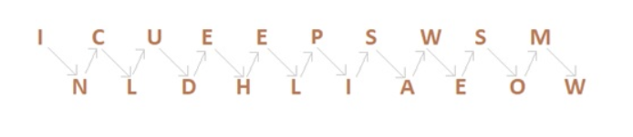
Example
Encrypt the message “INCLUDEHELP IS AWESOME” using Rail fence.
So the Cipher-text are, ICUEEPSWSMNLDHLIAEOW.

Slide 19
Example
Encrypt the message “FEAR CUTS DEEPER THAN SWORDS” using Rail fence with key= 4 Rows.

Slide 20
Transposition of Columns
It is a slight variation to the Rail-fence technique, let’s see its algorithm:
  In a rectangle of pre-defined size, write the plain-text message row by row.
  Read the plain message in random order in a column-wise fashion. It can be any order such as 2, 1, 3 etc.
  Thus Cipher-text is obtained.

Slide 21
Example
  Encrypt the message “INCLUDE HELP IS AWESOME” with key 4312
4 | 3 | 1 | 2
I | N | C | L
U | D | E | H
E | L | P | I
S | A | W | E
S | O | M | E

Slide 22
Continue…
  Answer????
1 | 2 | 3 | 4
C | L | N | I
E | H | D | U
P | I | L | E
W | E | A | S
M | E | O | S

Slide 23
Decryption
  CEPWMLHIEENDLAOIUESS
  Answer????
1 | 2 | 3 | 4
C | L | N | I
E | H | D | U
P | I | L | E
W | E | A | S
M | E | O | S

Slide 24
Example 2
  Encrypt the message “ THEY ARE ATTACKING FROM THE NORTH” with key 4312567 and Decrypt it back.

Slide 25
Double Transposition
  Two columnar transposition with different number of columns
    First transposition: breaks up adjacent letters
    Second transposition.: breaks up short patterns

Slide 26
Making “GOOD” Encryption Algorithm
    Substitution algorithm “Hide” the letters of the plaintext and Multiple Substitutions dissipate high letter frequencies
    Transposition scrambles text so that adjacent-character analysis fails
    Many “GOOD” algorithm combines both techniques

Slide 27
Shannon’s Characteristics of “GOOD” Ciphers
  The amount of secrecy needed should determine the amount of labor appropriate for the encryption and decryption.
  Set of keys and the enciphering algorithm should be free from complexity.
  Implementation should be simple.
  Errors in ciphering should not propogate.
  The size of the enciphered text should not be larger than the text of original message.

Slide 28
Symmetric and Asymmetric Encryption Systems
  Symmetric encryption requires one key for both encryption and decryption.
  Asymmetric requires two keys one of which is Public key i.e. used for Encryption and second one is Private kay i.e. used for decryption.

Slide 29
Stream and Block Cipher
    Stream cipher converts one symbol of plain text immediately into a symbol of ciphertext
    Block cipher encrypts a group of plaintext symbols as one block(eg. Columnar transposition)

Slide 30
Continue…
 | Stream | Block
Advantages | Speed of transformation Low error Propagation | High diffusion
Disadvantages | Low diffusion | Slowness of encryption

Slide 31
Confusion and Diffusion
  Confusion:- Interception cannot predict what will happen to the ciphertext by changing one character of the plaintext
  Diffusion:- Information from single plaintext is distributed over the entire ciphertext

Slide 32
Cryptanalysis
  Breaking encryption scheme
    Ciphertext only:- Requires analysis using probability, distribution and characteristics of the available text with publicly available knowledge
    Full or partial Plaintext:- Knows some plaintext and ciphertext, only need to determine the algorithm
    Ciphertext of any plain text:- Analyst can insert data into plain text to be encrypted
    Weakness:- Cryptanalysis often succeed because of human error and carelessness

Slide 33
Next Chapter
Security in netrworks!!!!

